Slide 1
Streamlining the registration- to-publication pipeline
Lyubomir Penev, Teodor Georgiev, Pavel Stoev
Sherborn Meeting, NHM London, 28 Oct 2011
ViBRANT

Slide 2
The registration workflow for taxonomic names and acts
AUTHOR
PUBLISHER
AUTHOR
PRE-PUBLICATION REGISTRATION
TaxonomIC
PUBLICATION
POST-PUBLICATION RECORDING
ZooBank
MycoBank
Index Animalium
Zoological Record
Index Kewensis, IPNI
Index Fungorum
XML MARK UP
IPNI
Index Fungorum
Structured text (data!)
ARTICLES
Biblio- graphies
Occurr- ence data
Taxon treatments
Taxon names
Plazi
Wiki
COL
BHL

Slide 3
XML-based publication and dissemination workflow
bn
GBIF-generated manuscripts from metadata descriptions
Scratchpads-
generated manuscripts
Manuscripts written via customized online forms
Manuscripts generated from
authors’ databases
Upfront pre-submission marked up manuscripts
Marked up final publication in PDF, HTML and XML formats
PENSOFT MARK UP TOOL (PMT)
Non-tagged manuscripts
(MS Word, Open Office)
Peer-review, editorial and publication process
Automated dissemination, archiving, indexing, harvesting
ARTICLES
Occurrence data
Taxon treatments
Taxon names
Plazi
Wiki
COL
BHL

Slide 4
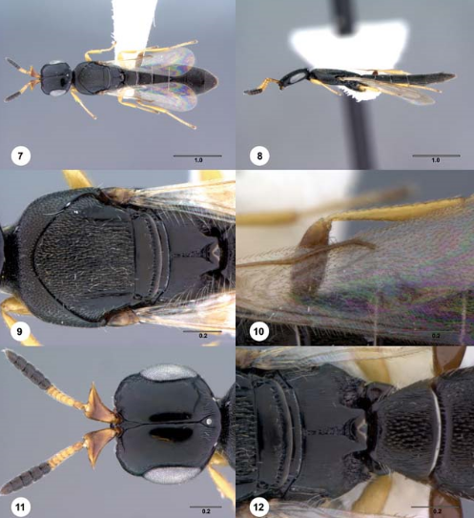
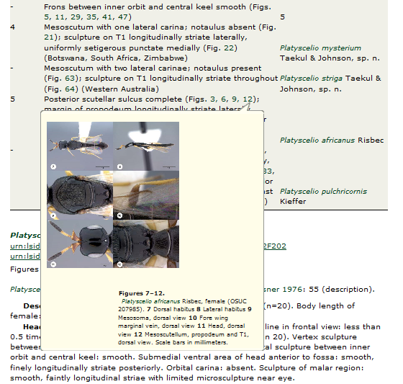
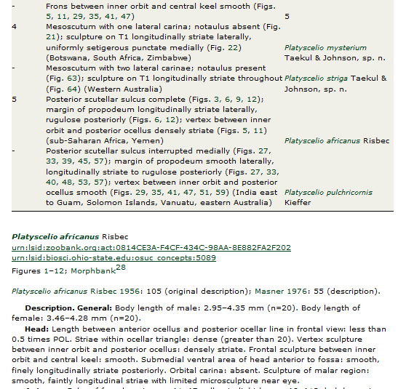
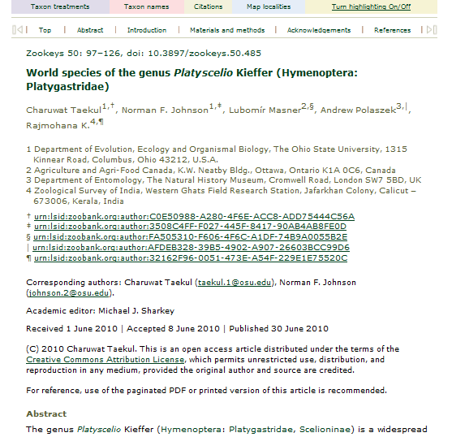
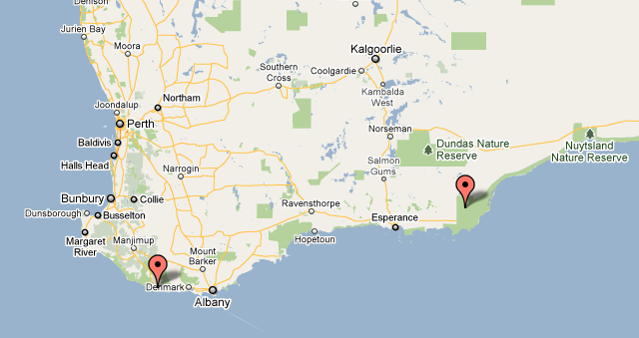
But why doing all this ?

Slide 5
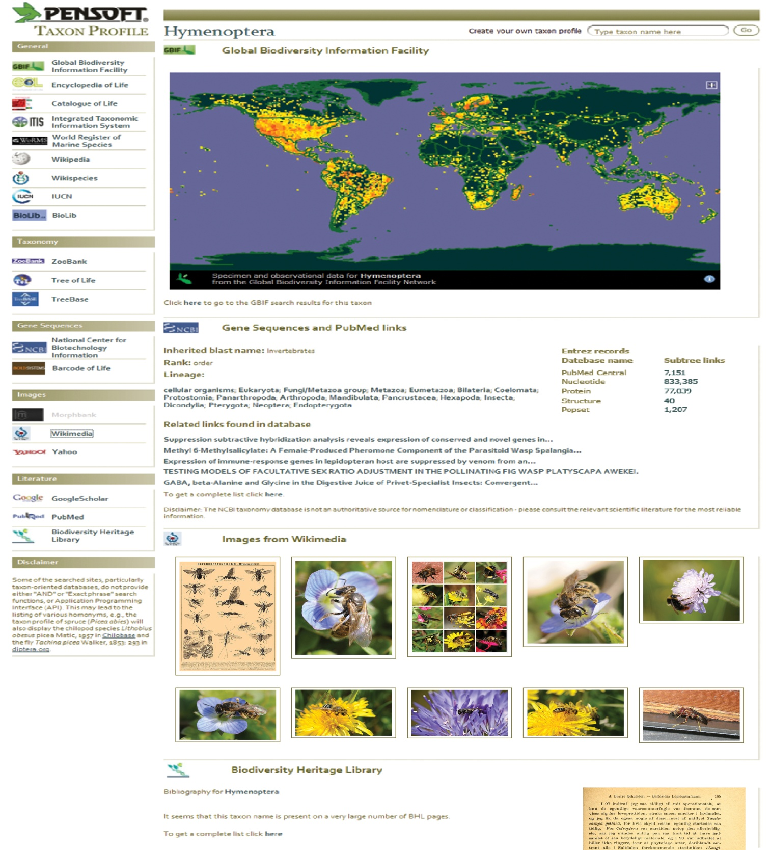
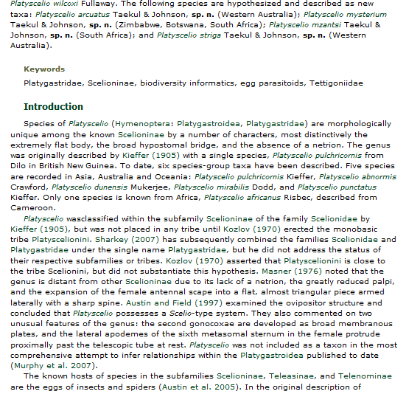
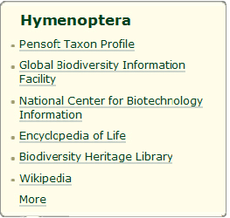
Semantic enhancements to published texts

Slide 6
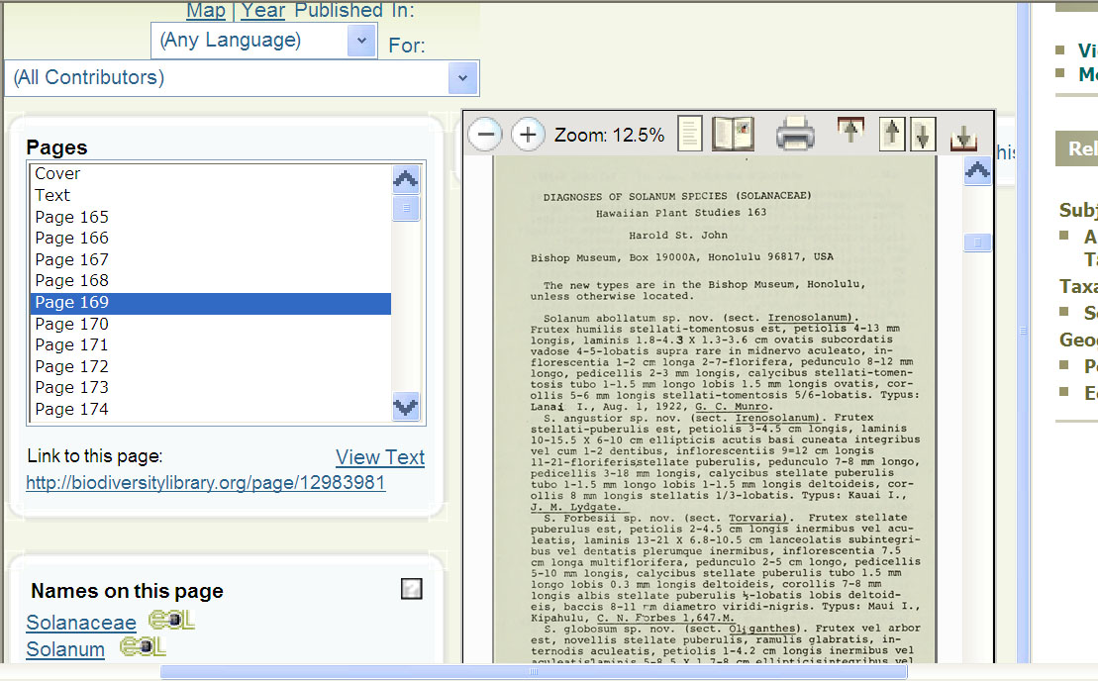
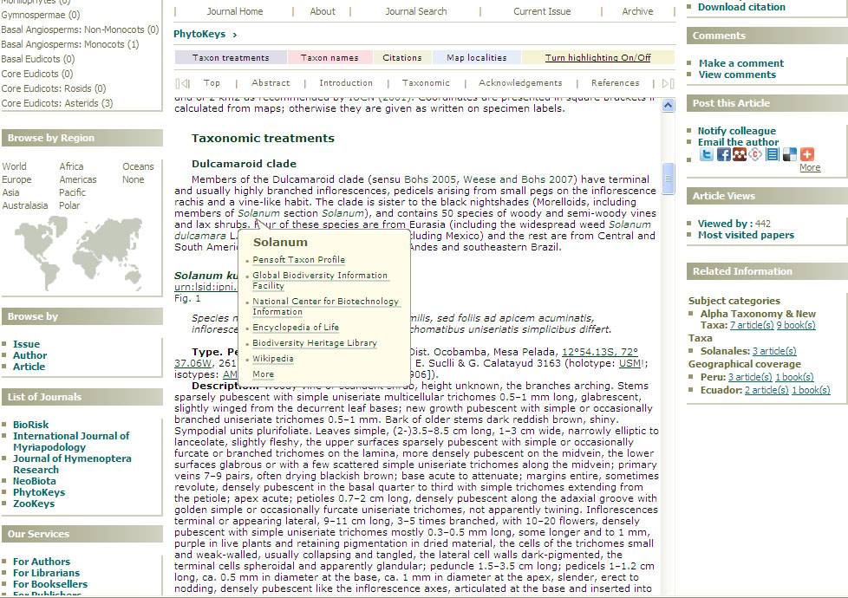
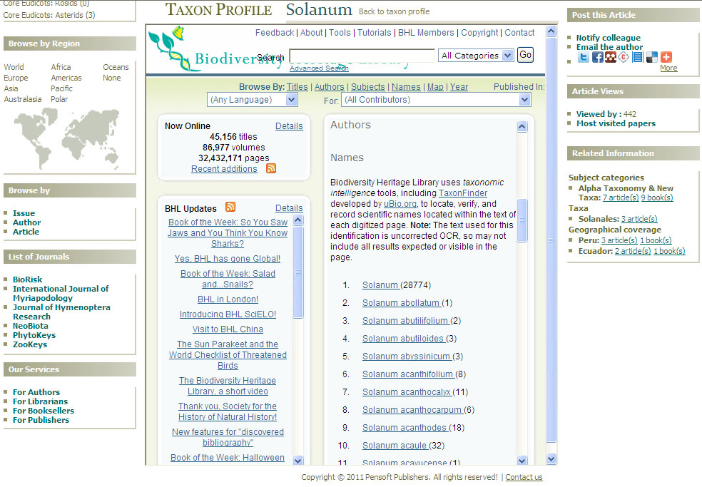
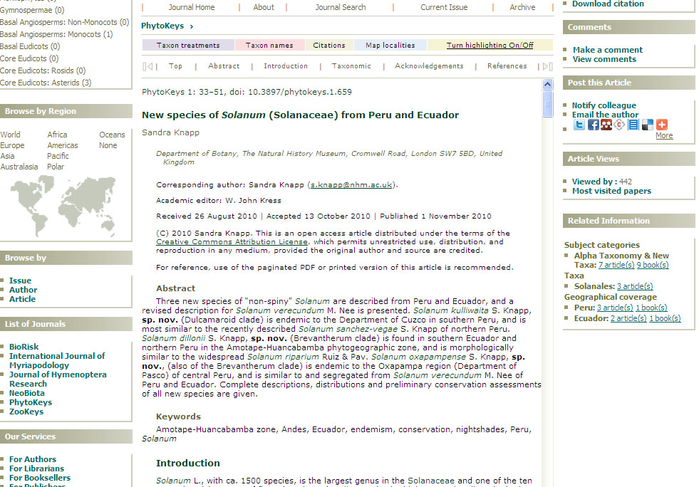

Slide 7
The challenges of the registration process
Four different groups of players: data managers, registry editors, authors, publishers
Who will be “allowed” to register new data in electronic registries?
Who will control the quality of (validate) registered records?
Who will supply the record ID numbers to the publishers?
Who and when will add/correct the article metadata after publication?

Slide 8
Automated workflow
Manuscript SUBMISSION
Peer review
XML Query
MANUSCRIPT ACCEPTED
XML Response
XML article metadata
ARTICLE PUBLISHED
Taxon name available
(effectively published)

Slide 9
The technical solution:
Pensoft Writing Tool (PWT)

Slide 10
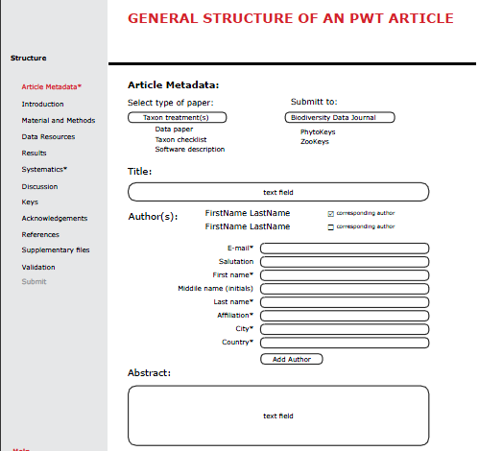

Slide 11
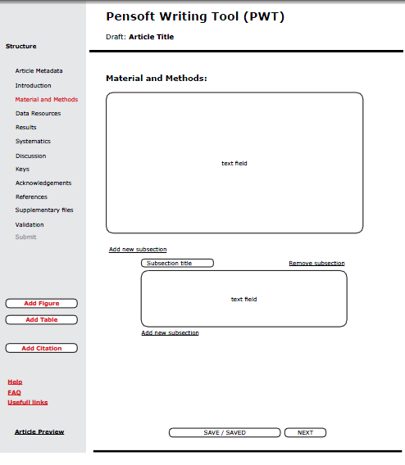

Slide 12
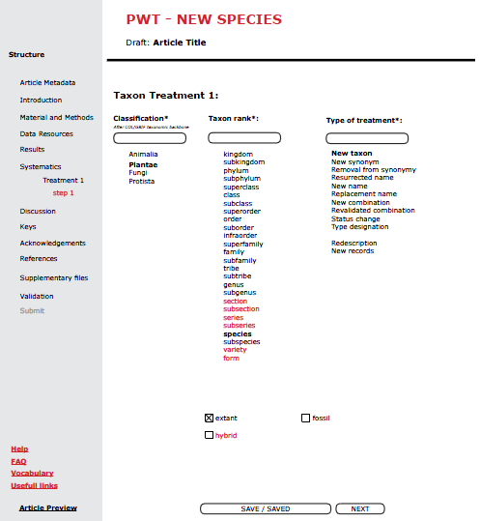

Slide 13
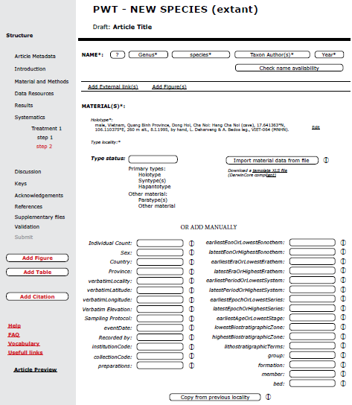

Slide 14
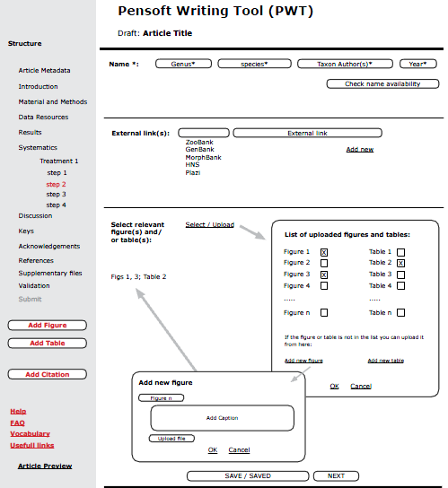

Slide 15
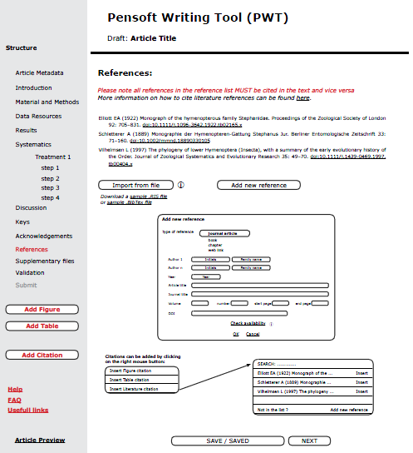

Slide 16
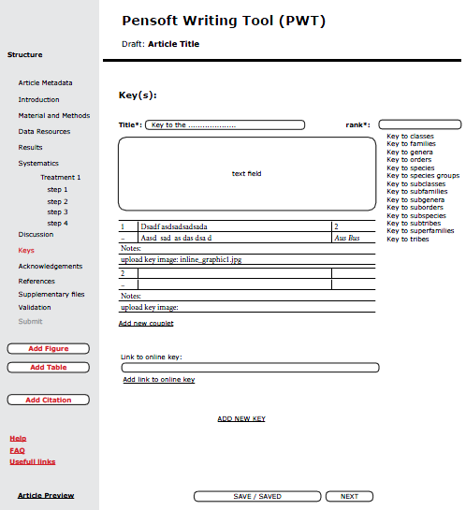

Slide 17
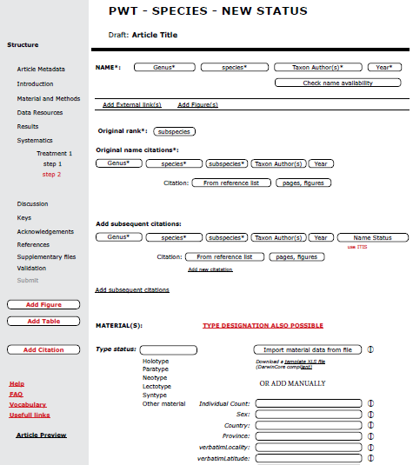

Slide 18
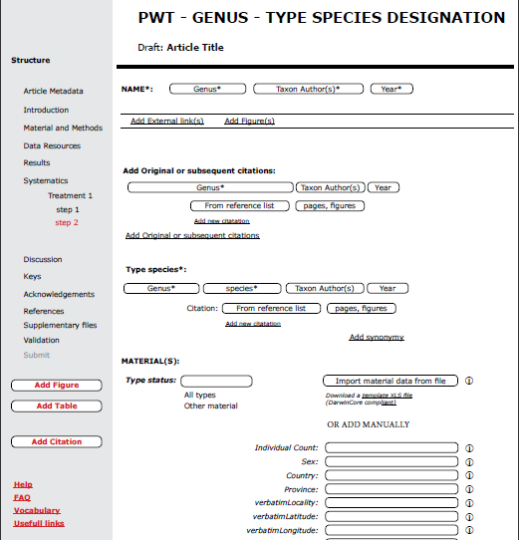

Slide 19
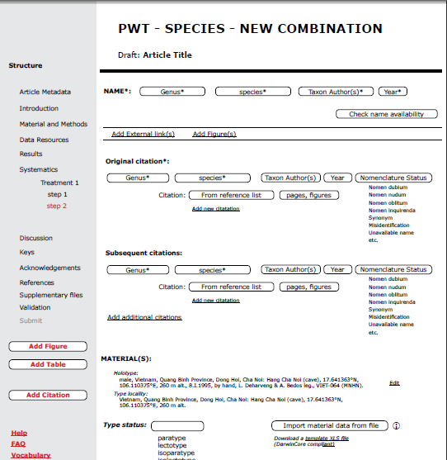

Slide 20
PWT – Main functionalities
PWT combines: (1) writing of a taxonomic manuscript (2) upfront markup of the text (3) submission to an appropriate journal into one and the same process (tool)
PWT is a core module of the forthcoming Biodiversity Data Journal (BDJ)
Short taxonomic treatments or even single nomenclatural acts, single records, biological and ecological observations, local checklists, larger taxonomic revisions, etc.
Compliant to the two Biological Codes (bacteria still missing)
Can be used as educational environment for the future taxonomists

Slide 21
Acknowledments
Plazi
ViBRANT

Slide 22
All this is not easy, but......
... it is truly exciting
...but
... is possible only through Open Access!
“ Semi-automatically generated semantic, enhanced e-publications are the only way to describe the missing 10 M species, and to deal with an increasing flood of data.” Donat Agosti

Slide 23
I Open Access!
Thank you for your attention!

